Slide 1
DATA MINING LECTURE 7
Clustering

Slide 2
CLUSTERING

Slide 3
What is a Clustering?
In general a grouping of objects such that the objects in a group (cluster) are similar (or related) to one another and different from (or unrelated to) the objects in other groups
Inter-cluster distances are maximized
Intra-cluster distances are minimized

Slide 4
What is Cluster Analysis?
Cluster: A collection of data objects
similar (or related) to one another within the same group
dissimilar (or unrelated) to the objects in other groups
Cluster analysis (or clustering, data segmentation, …)
Finding similarities between data according to the characteristics found in the data and grouping similar data objects into clusters
Unsupervised learning: no predefined classes (i.e., learning by observations vs. learning by examples: supervised)
Typical applications
As a stand-alone tool to get insight into data distribution
As a preprocessing step for other algorithms

Slide 5
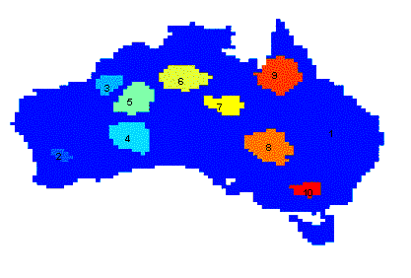
Applications of Cluster Analysis
Understanding
Group related documents for browsing, group genes and proteins that have similar functionality, or group stocks with similar price fluctuations
Summarization
Reduce the size of large data sets
Clustering precipitation in Australia

Slide 6
Clustering for Data Understanding and Applications
Biology: taxonomy of living things: kingdom, phylum, class, order, family, genus and species
Information retrieval: document clustering
Land use: Identification of areas of similar land use in an earth observation database
Marketing: Help marketers discover distinct groups in their customer bases, and then use this knowledge to develop targeted marketing programs
City-planning: Identifying groups of houses according to their house type, value, and geographical location
Earth-quake studies: Observed earth quake epicenters should be clustered along continent faults
Climate: understanding earth climate, find patterns of atmospheric and ocean
Economic Science: market resarch

Slide 7
Clustering as a Preprocessing Tool (Utility)
Summarization:
Preprocessing for regression, PCA, classification, and association analysis
Compression:
Image processing: vector quantization
Finding K-nearest Neighbors
Localizing search to one or a small number of clusters
Outlier detection
Outliers are often viewed as those “far away” from any cluster

Slide 8
Notion of a Cluster can be Ambiguous
How many clusters?
Six Clusters
Two Clusters
Four Clusters

Slide 9
Quality: What Is Good Clustering?
A good clustering method will produce high quality clusters
high intra-class similarity: cohesive within clusters
low inter-class similarity: distinctive between clusters
The quality of a clustering method depends on
the similarity measure used by the method
its implementation, and
Its ability to discover some or all of the hidden patterns

Slide 10
Measure the Quality of Clustering
Dissimilarity/Similarity metric
Similarity is expressed in terms of a distance function, typically metric: d(i, j)
The definitions of distance functions are usually rather different for interval-scaled, boolean, categorical, ordinal ratio, and vector variables
Weights should be associated with different variables based on applications and data semantics
Quality of clustering:
There is usually a separate “quality” function that measures the “goodness” of a cluster.
It is hard to define “similar enough” or “good enough”
The answer is typically highly subjective

Slide 11
Considerations for Cluster Analysis
Partitioning criteria
Single level vs. hierarchical partitioning (often, multi-level hierarchical partitioning is desirable)
Separation of clusters
Exclusive (e.g., one customer belongs to only one region) vs. non-exclusive (e.g., one document may belong to more than one class)
Similarity measure
Distance-based (e.g., Euclidian, road network, vector) vs. connectivity-based (e.g., density or contiguity)
Clustering space
Full space (often when low dimensional) vs. subspaces (often in high-dimensional clustering)

Slide 12
Requirements and Challenges
Scalability
Clustering all the data instead of only on samples
Ability to deal with different types of attributes
Numerical, binary, categorical, ordinal, linked, and mixture of these
Constraint-based clustering
User may give inputs on constraints
Use domain knowledge to determine input parameters
Interpretability and usability
Others
Discovery of clusters with arbitrary shape
Ability to deal with noisy data
Incremental clustering and insensitivity to input order
High dimensionality

Slide 13
Major Clustering Approaches (I)
Partitioning approach:
Construct various partitions and then evaluate them by some criterion, e.g., minimizing the sum of square errors
Typical methods: k-means, k-medoids, CLARANS
Hierarchical approach:
Create a hierarchical decomposition of the set of data (or objects) using some criterion
Typical methods: Diana, Agnes, BIRCH, CAMELEON
Density-based approach:
Based on connectivity and density functions
Typical methods: DBSACN, OPTICS, DenClue
Grid-based approach:
based on a multiple-level granularity structure
Typical methods: STING, WaveCluster, CLIQUE

Slide 14
Major Clustering Approaches (II)
Model-based:
A model is hypothesized for each of the clusters and tries to find the best fit of that model to each other
Typical methods: EM, SOM, COBWEB
Frequent pattern-based:
Based on the analysis of frequent patterns
Typical methods: p-Cluster
User-guided or constraint-based:
Clustering by considering user-specified or application-specific constraints
Typical methods: COD (obstacles), constrained clustering
Link-based clustering:
Objects are often linked together in various ways
Massive links can be used to cluster objects: SimRank, LinkClus

Slide 15
Types of Clustering
A clustering is a set of clusters
Important distinction between hierarchical and partitional sets of clusters
Partitional Clustering
A division data objects into subsets (clusters) such that each data object is in exactly one subset
Hierarchical clustering
A set of nested clusters organized as a hierarchical tree

Slide 16
Partitional Clustering
Original Points
A Partitional Clustering

Slide 17
Hierarchical Clustering
Traditional Hierarchical Clustering
Traditional Dendrogram
Non-traditional Hierarchical Clustering
Non-traditional Dendrogram

Slide 18
Other types of clustering
Exclusive (or non-overlapping) versus non-exclusive (or overlapping)
In non-exclusive clusterings, points may belong to multiple clusters.
Points that belong to multiple classes, or ‘border’ points
Fuzzy (or soft) versus non-fuzzy (or hard)
In fuzzy clustering, a point belongs to every cluster with some weight between 0 and 1
Weights usually must sum to 1 (often interpreted as probabilities)
Partial versus complete
In some cases, we only want to cluster some of the data

Slide 19
Types of Clusters: Well-Separated
Well-Separated Clusters:
A cluster is a set of points such that any point in a cluster is closer (or more similar) to every other point in the cluster than to any point not in the cluster.
3 well-separated clusters

Slide 20
Types of Clusters: Center-Based
Center-based
A cluster is a set of objects such that an object in a cluster is closer (more similar) to the “center” of a cluster, than to the center of any other cluster
The center of a cluster is often a centroid, the minimizer of distances from all the points in the cluster, or a medoid, the most “representative” point of a cluster
4 center-based clusters

Slide 21
Types of Clusters: Contiguity-Based
Contiguous Cluster (Nearest neighbor or Transitive)
A cluster is a set of points such that a point in a cluster is closer (or more similar) to one or more other points in the cluster than to any point not in the cluster.
8 contiguous clusters

Slide 22
Types of Clusters: Density-Based
Density-based
A cluster is a dense region of points, which is separated by low-density regions, from other regions of high density.
Used when the clusters are irregular or intertwined, and when noise and outliers are present.
6 density-based clusters

Slide 23
Types of Clusters: Conceptual Clusters
Shared Property or Conceptual Clusters
Finds clusters that share some common property or represent a particular concept.
.
2 Overlapping Circles

Slide 24
Types of Clusters: Objective Function
Clustering as an optimization problem
Finds clusters that minimize or maximize an objective function.
Enumerate all possible ways of dividing the points into clusters and evaluate the `goodness' of each potential set of clusters by using the given objective function. (NP Hard)
Can have global or local objectives.
Hierarchical clustering algorithms typically have local objectives
Partitional algorithms typically have global objectives
A variation of the global objective function approach is to fit the data to a parameterized model.
The parameters for the model are determined from the data, and they determine the clustering
E.g., Mixture models assume that the data is a ‘mixture' of a number of statistical distributions.

Slide 25
Clustering Algorithms
K-means and its variants
Hierarchical clustering
DBSCAN

Slide 26
K-means

Slide 27
K-means Clustering
Partitional clustering approach
Each cluster is associated with a centroid (center point)
Each point is assigned to the cluster with the closest centroid
Number of clusters, K, must be specified
The objective is to minimize the sum of distances of the points to their respective centroid

Slide 28
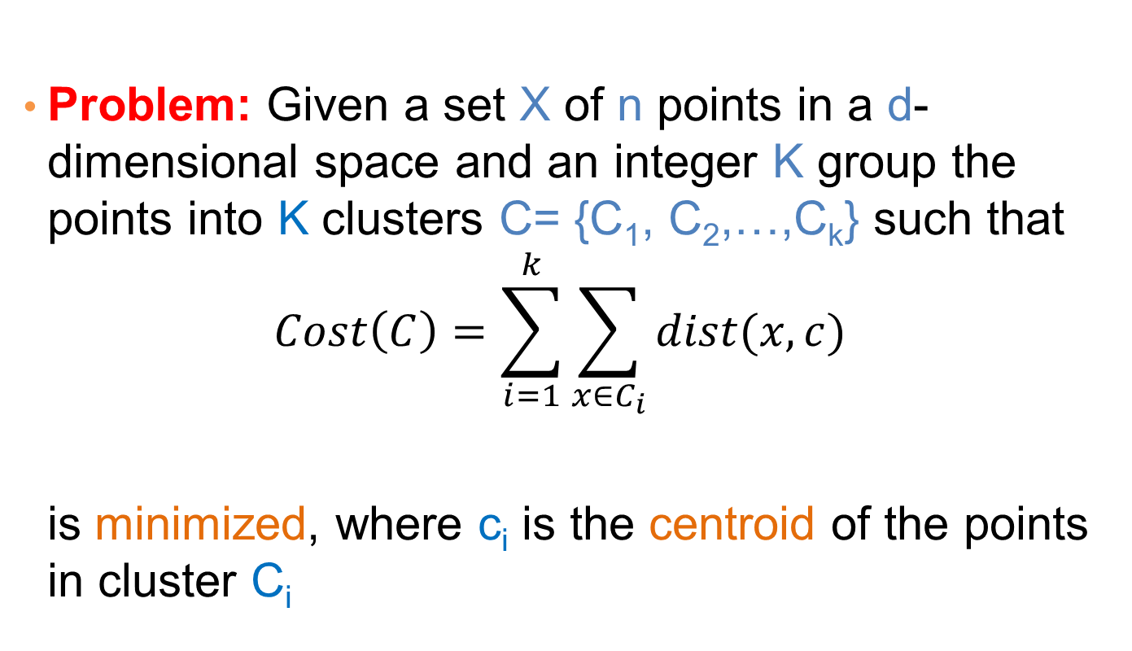
K-means Clustering
Problem: Given a set X of n points in a d-dimensional space and an integer K group the points into K clusters C= {C₁, C₂,…,C_{k}} such that
$$Cost\left(C\right)=\sum_{i=1}^{k}{\sum_{x∈C_{i}}{dist(x,c)}}$$
is minimized, where c_{i} is the centroid of the points in cluster C_{i}

Slide 29
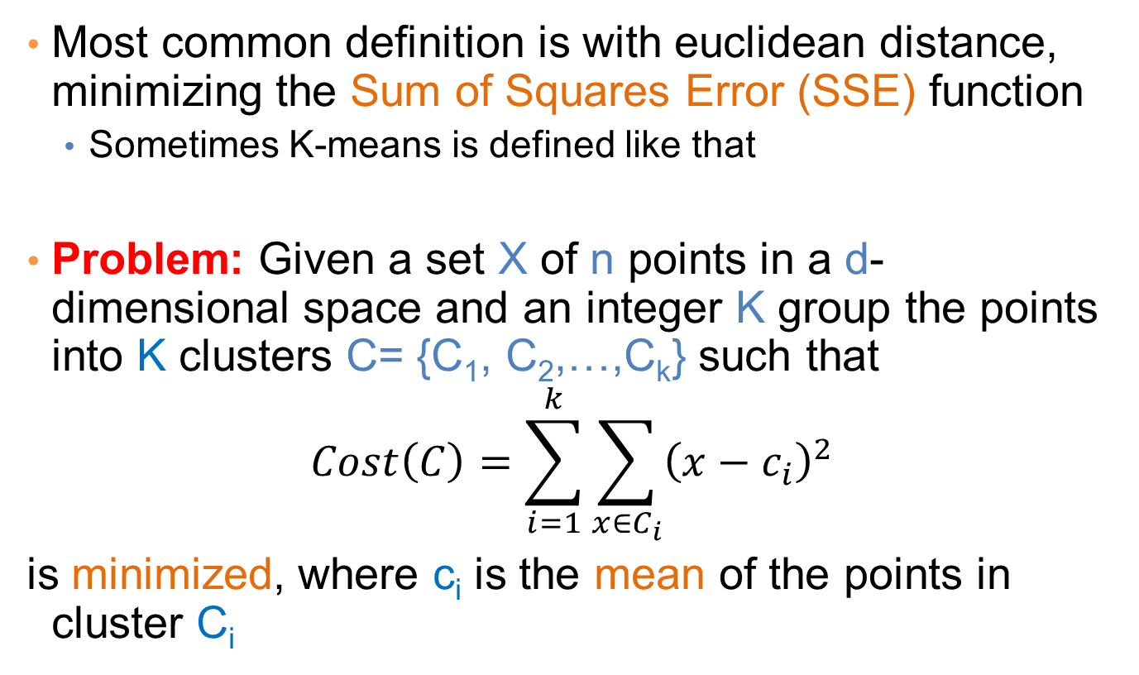
K-means Clustering
Most common definition is with euclidean distance, minimizing the Sum of Squares Error (SSE) function
Sometimes K-means is defined like that
Problem: Given a set X of n points in a d-dimensional space and an integer K group the points into K clusters C= {C₁, C₂,…,C_{k}} such that
$$Cost\left(C\right)=\sum_{i=1}^{k}{\sum_{x∈C_{i}}{{\left(x−c_{i}\right)}^{2}}}$$
is minimized, where c_{i} is the mean of the points in cluster C_{i}
Sum of Squares Error (SSE)

Slide 30
Complexity of the k-means problem
NP-hard if the dimensionality of the data is at least 2 (d>=2)
Finding the best solution in polynomial time is infeasible
For d=1 the problem is solvable in polynomial time (how?)
A simple iterative algorithm works quite well in practice

Slide 31
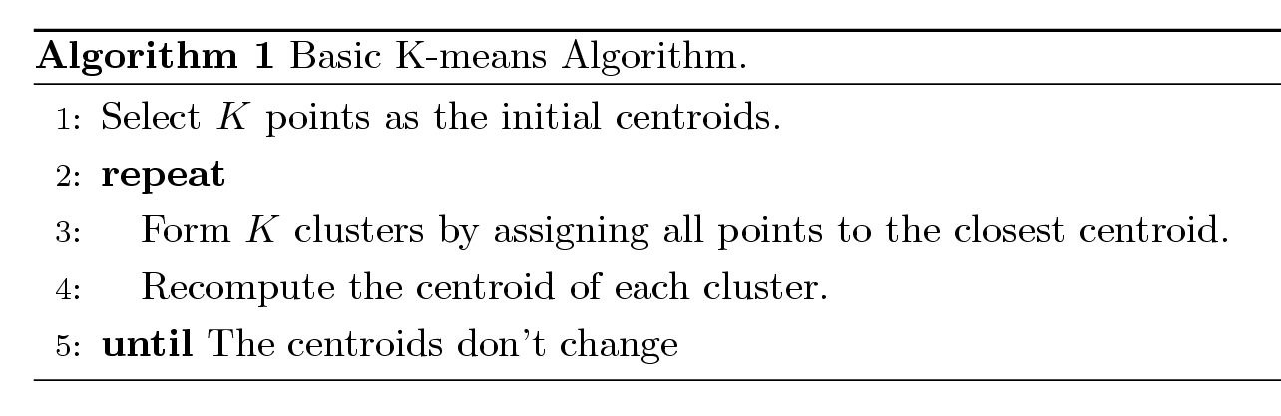
K-means Algorithm
Also known as Lloyd’s algorithm.
K-means is sometimes synonymous with this algorithm

Slide 32
K-means Algorithm – Initialization
Initial centroids are often chosen randomly.
Clusters produced vary from one run to another.

Slide 33
Two different K-means Clusterings
Original Points
Optimal Clustering
Sub-optimal Clustering

Slide 34
Importance of Choosing Initial Centroids

Slide 35
Importance of Choosing Initial Centroids

Slide 36
Importance of Choosing Initial Centroids

Slide 37
Importance of Choosing Initial Centroids …

Slide 38
Dealing with Initialization
Do multiple runs and select the clustering with the smallest error
Select original set of points by methods other than random . E.g., pick the most distant (from each other) points as cluster centers (K-means++ algorithm)

Slide 39
K-means Algorithm – Centroids
The centroid depends on the distance function
The minimizer for the distance function
‘Closeness’ is measured by Euclidean distance (SSE), cosine similarity, correlation, etc.
Centroid:
The mean of the points in the cluster for SSE, and cosine similarity
The median for Manhattan distance.
Finding the centroid is not always easy
It can be an NP-hard problem for some distance functions
E.g., median form multiple dimensions

Slide 40
K-means Algorithm – Convergence
K-means will converge for common similarity measures mentioned above.
Most of the convergence happens in the first few iterations.
Often the stopping condition is changed to ‘Until relatively few points change clusters’
Complexity is O( n * K * I * d )
n = number of points, K = number of clusters, I = number of iterations, d = dimensionality
In general a fast and efficient algorithm

Slide 41
Limitations of K-means
K-means has problems when clusters are of different
Sizes
Densities
Non-globular shapes
K-means has problems when the data contains outliers.

Slide 42
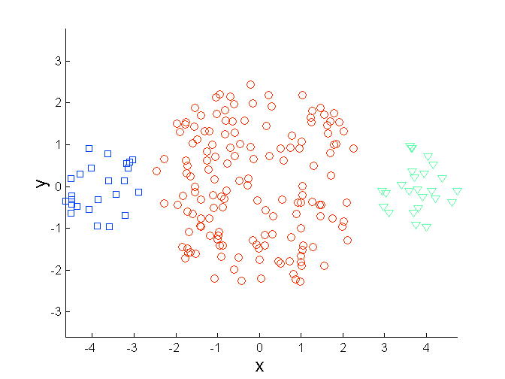
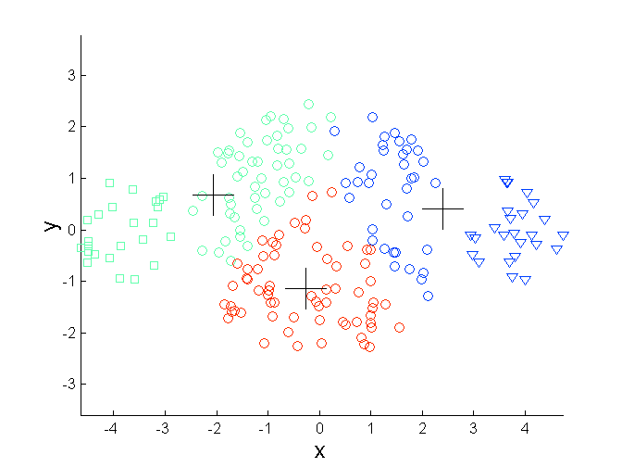
Limitations of K-means: Differing Sizes
Original Points
K-means (3 Clusters)

Slide 43
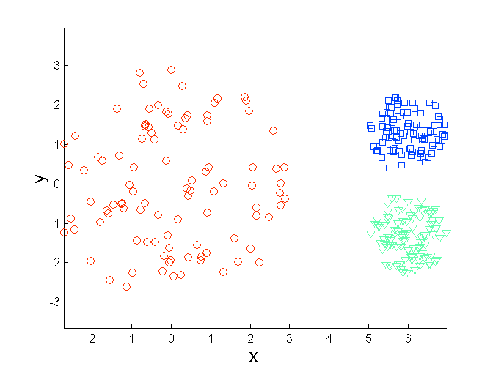
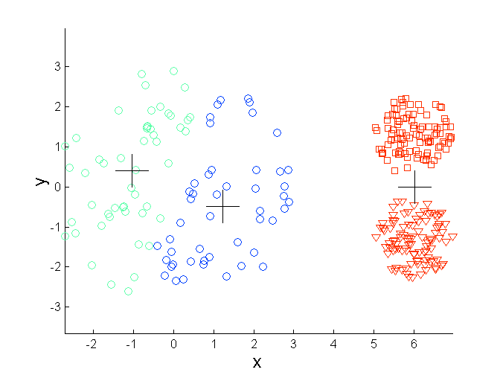
Limitations of K-means: Differing Density
Original Points
K-means (3 Clusters)

Slide 44
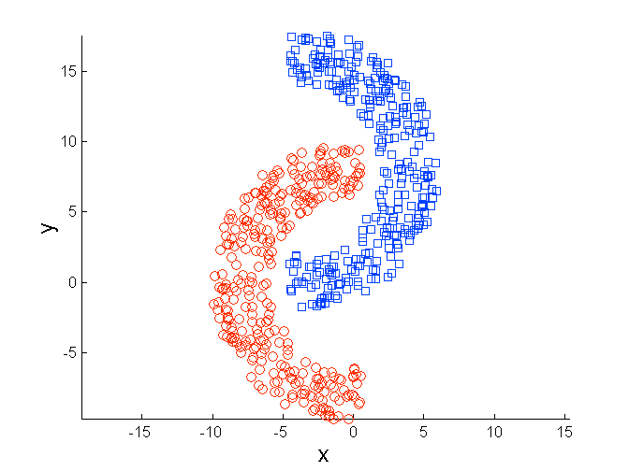
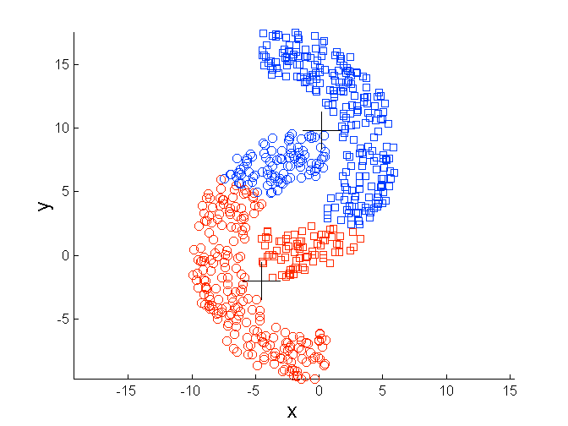
Limitations of K-means: Non-globular Shapes
Original Points
K-means (2 Clusters)

Slide 45
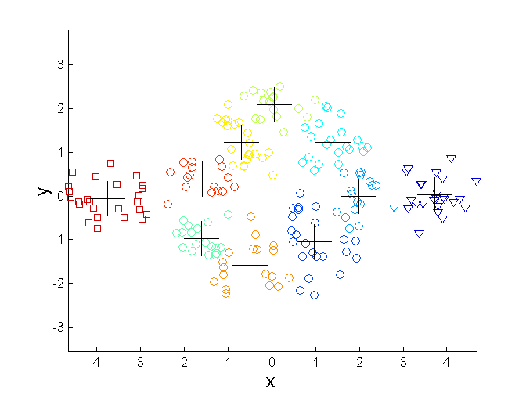
Overcoming K-means Limitations
Original Points K-means Clusters
One solution is to use many clusters.
Find parts of clusters, but need to put together.

Slide 46
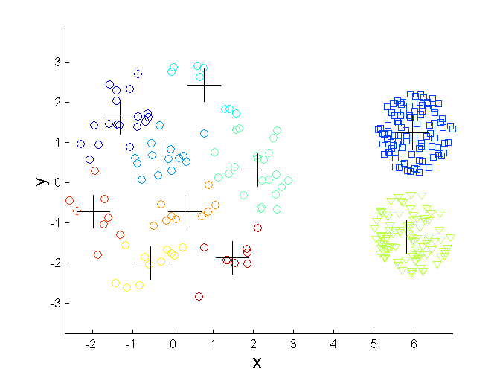
Overcoming K-means Limitations
Original Points K-means Clusters

Slide 47
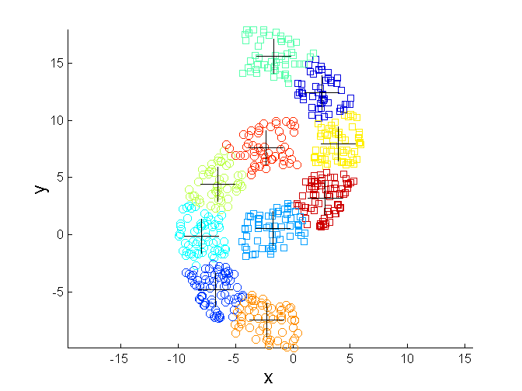
Overcoming K-means Limitations
Original Points K-means Clusters

Slide 48
Variations
K-medoids: Similar problem definition as in K-means, but the centroid of the cluster is defined to be one of the points in the cluster (the medoid).
K-centers: Similar problem definition as in K-means, but the goal now is to minimize the maximum diameter of the clusters (diameter of a cluster is maximum distance between any two points in the cluster).

Slide 49
HIERARCHICAL CLUSTERING

Slide 50
Hierarchical Clustering
Two main types of hierarchical clustering
Agglomerative:
Start with the points as individual clusters
At each step, merge the closest pair of clusters until only one cluster (or k clusters) left
Divisive:
Start with one, all-inclusive cluster
At each step, split a cluster until each cluster contains a point (or there are k clusters)
Traditional hierarchical algorithms use a similarity or distance matrix
Merge or split one cluster at a time

Slide 51
Hierarchical Clustering
Produces a set of nested clusters organized as a hierarchical tree
Can be visualized as a dendrogram
A tree like diagram that records the sequences of merges or splits

Slide 52
Strengths of Hierarchical Clustering
Do not have to assume any particular number of clusters
Any desired number of clusters can be obtained by ‘cutting’ the dendogram at the proper level
They may correspond to meaningful taxonomies
Example in biological sciences (e.g., animal kingdom, phylogeny reconstruction, …)

Slide 53
Agglomerative Clustering Algorithm
More popular hierarchical clustering technique
Basic algorithm is straightforward
Compute the proximity matrix
Let each data point be a cluster
Repeat
Merge the two closest clusters
Update the proximity matrix
Until only a single cluster remains
Key operation is the computation of the proximity of two clusters
Different approaches to defining the distance between clusters distinguish the different algorithms

Slide 54
Starting Situation
Start with clusters of individual points and a proximity matrix
p1
p2
p3
p4
p5
. . .
p1
p2
p3
p4
p5
.
.
.
Proximity Matrix

Slide 55
Intermediate Situation
After some merging steps, we have some clusters
C1
C2
C3
C4
C5
C1
C2
C3
C3
C4
C4
C5
C1
Proximity Matrix
C2
C5

Slide 56
Intermediate Situation
We want to merge the two closest clusters (C2 and C5) and update the proximity matrix.
C1
C2
C3
C4
C5
C1
C2
C3
C3
C4
C4
C5
Proximity Matrix
C1
C2
C5

Slide 57
After Merging
The question is “How do we update the proximity matrix?”
C2 U C5
C1
C3
C4
C1
?
C2 U C5
? ? ? ?
C3
C3
?
C4
C4
?
C1
Proximity Matrix
C2 U C5

Slide 58
How to Define Inter-Cluster Similarity
p1
p2
p3
p4
p5
. . .
p1
Similarity?
p2
p3
p4
p5
MIN
MAX
Group Average
Distance Between Centroids
Other methods driven by an objective function
Ward’s Method uses squared error
.
.
.
Proximity Matrix

Slide 59
How to Define Inter-Cluster Similarity
p1
p2
p3
p4
p5
. . .
p1
p2
p3
p4
p5
MIN
MAX
Group Average
Distance Between Centroids
Other methods driven by an objective function
Ward’s Method uses squared error
.
.
.
Proximity Matrix

Slide 60
How to Define Inter-Cluster Similarity
p1
p2
p3
p4
p5
. . .
p1
p2
p3
p4
p5
MIN
MAX
Group Average
Distance Between Centroids
Other methods driven by an objective function
Ward’s Method uses squared error
.
.
.
Proximity Matrix

Slide 61
How to Define Inter-Cluster Similarity
p1
p2
p3
p4
p5
. . .
p1
p2
p3
p4
p5
MIN
MAX
Group Average
Distance Between Centroids
Other methods driven by an objective function
Ward’s Method uses squared error
.
.
.
Proximity Matrix

Slide 62
How to Define Inter-Cluster Similarity
p1
p2
p3
p4
p5
. . .
p1
×
×
p2
p3
p4
p5
MIN
MAX
Group Average
Distance Between Centroids
Other methods driven by an objective function
Ward’s Method uses squared error
.
.
.
Proximity Matrix

Slide 63
Single Link – Complete Link
Another way to view the processing of the hierarchical algorithm is that we create links between their elements in order of increasing distance
The MIN – Single Link, will merge two clusters when a single pair of elements is linked
The MAX – Complete Linkage will merge two clusters when all pairs of elements have been linked.

Slide 64
Hierarchical Clustering: MIN
 | 1 | 2 | 3 | 4 | 5 | 6
1 | 0 | .24 | .22 | .37 | .34 | .23
2 | .24 | 0 | .15 | .20 | .14 | .25
3 | .22 | .15 | 0 | .15 | .28 | .11
4 | .37 | .20 | .15 | 0 | .29 | .22
5 | .34 | .14 | .28 | .29 | 0 | .39
6 | .23 | .25 | .11 | .22 | .39 | 0
5
1
3
5
2
1
2
3
6
4
4
Nested Clusters
Dendrogram

Slide 65
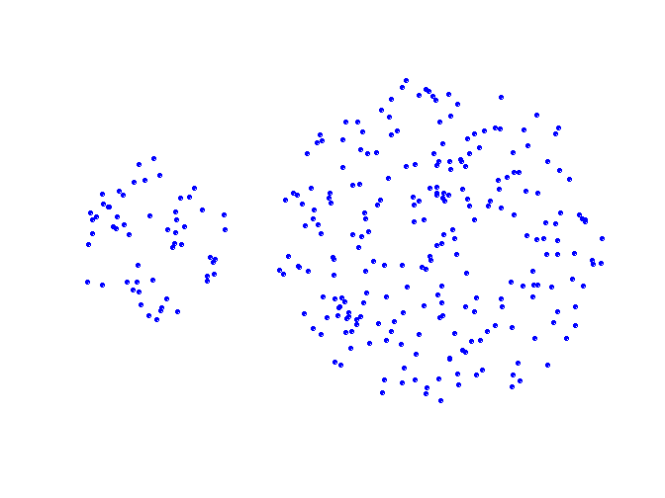
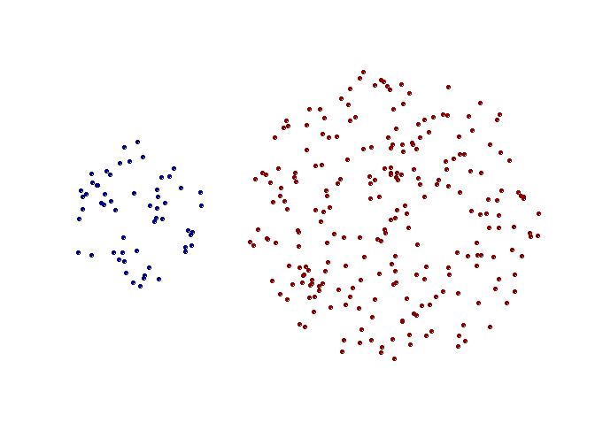
Strength of MIN
Original Points
Two Clusters
Can handle non-elliptical shapes

Slide 66
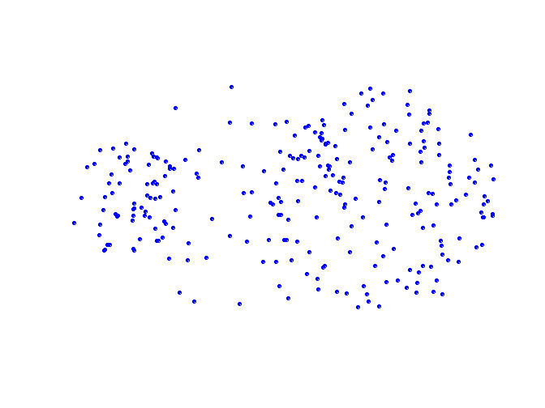
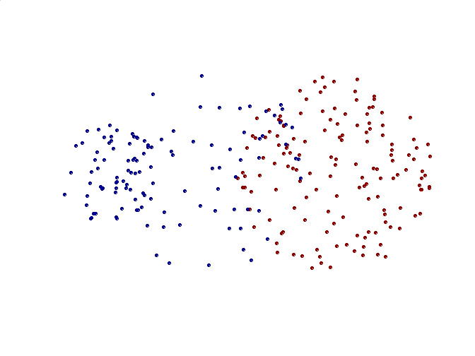
Limitations of MIN
Original Points
Two Clusters
Sensitive to noise and outliers

Slide 67
Hierarchical Clustering: MAX
 | 1 | 2 | 3 | 4 | 5 | 6
1 | 0 | .24 | .22 | .37 | .34 | .23
2 | .24 | 0 | .15 | .20 | .14 | .25
3 | .22 | .15 | 0 | .15 | .28 | .11
4 | .37 | .20 | .15 | 0 | .29 | .22
5 | .34 | .14 | .28 | .29 | 0 | .39
6 | .23 | .25 | .11 | .22 | .39 | 0
4
1
2
5
5
2
3
6
3
1
4
Nested Clusters
Dendrogram

Slide 68
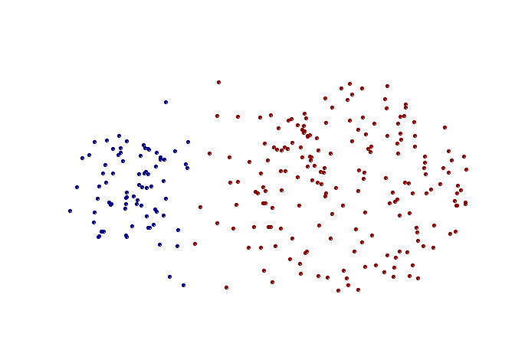
Strength of MAX
Original Points
Two Clusters
Less susceptible to noise and outliers

Slide 69
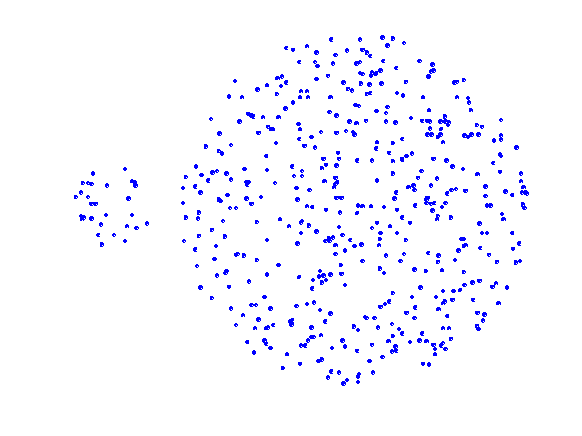
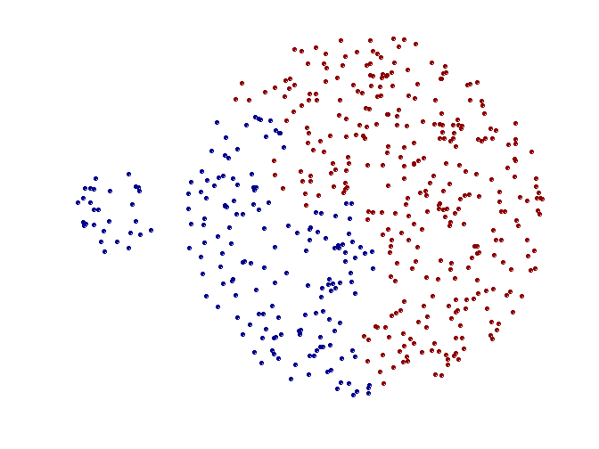
Limitations of MAX
Original Points
Two Clusters
Tends to break large clusters
Biased towards globular clusters

Slide 70
Cluster Similarity: Group Average
Proximity of two clusters is the average of pairwise proximity between points in the two clusters.
Need to use average connectivity for scalability since total proximity favors large clusters
 | 1 | 2 | 3 | 4 | 5 | 6
1 | 0 | .24 | .22 | .37 | .34 | .23
2 | .24 | 0 | .15 | .20 | .14 | .25
3 | .22 | .15 | 0 | .15 | .28 | .11
4 | .37 | .20 | .15 | 0 | .29 | .22
5 | .34 | .14 | .28 | .29 | 0 | .39
6 | .23 | .25 | .11 | .22 | .39 | 0

Slide 71
Hierarchical Clustering: Group Average
 | 1 | 2 | 3 | 4 | 5 | 6
1 | 0 | .24 | .22 | .37 | .34 | .23
2 | .24 | 0 | .15 | .20 | .14 | .25
3 | .22 | .15 | 0 | .15 | .28 | .11
4 | .37 | .20 | .15 | 0 | .29 | .22
5 | .34 | .14 | .28 | .29 | 0 | .39
6 | .23 | .25 | .11 | .22 | .39 | 0
5
4
1
2
5
2
3
6
1
4
3
Nested Clusters
Dendrogram

Slide 72
Hierarchical Clustering: Group Average
Compromise between Single and Complete Link
Strengths
Less susceptible to noise and outliers
Limitations
Biased towards globular clusters

Slide 73
Cluster Similarity: Ward’s Method
Similarity of two clusters is based on the increase in squared error (SSE) when two clusters are merged
Similar to group average if distance between points is distance squared
Less susceptible to noise and outliers
Biased towards globular clusters
Hierarchical analogue of K-means
Can be used to initialize K-means

Slide 74
Hierarchical Clustering: Comparison
5
1
4
1
3
2
5
5
5
2
1
MIN
2
MAX
2
3
6
3
3
6
1
4
4
4
5
5
1
4
1
2
2
5
2
Ward’s Method
5
2
3
6
Group Average
3
3
6
4
1
1
4
4
3

Slide 75
Hierarchical Clustering: Time and Space requirements
O(N²) space since it uses the proximity matrix.
N is the number of points.
O(N³) time in many cases
There are N steps and at each step the size, N², proximity matrix must be updated and searched
Complexity can be reduced to O(N² log(N) ) time for some approaches

Slide 76
Hierarchical Clustering: Problems and Limitations
Computational complexity in time and space
Once a decision is made to combine two clusters, it cannot be undone
No objective function is directly minimized
Different schemes have problems with one or more of the following:
Sensitivity to noise and outliers
Difficulty handling different sized clusters and convex shapes
Breaking large clusters

